Slide 1
A graph interpreter for DSP/ML stream-based processing

Slide 2
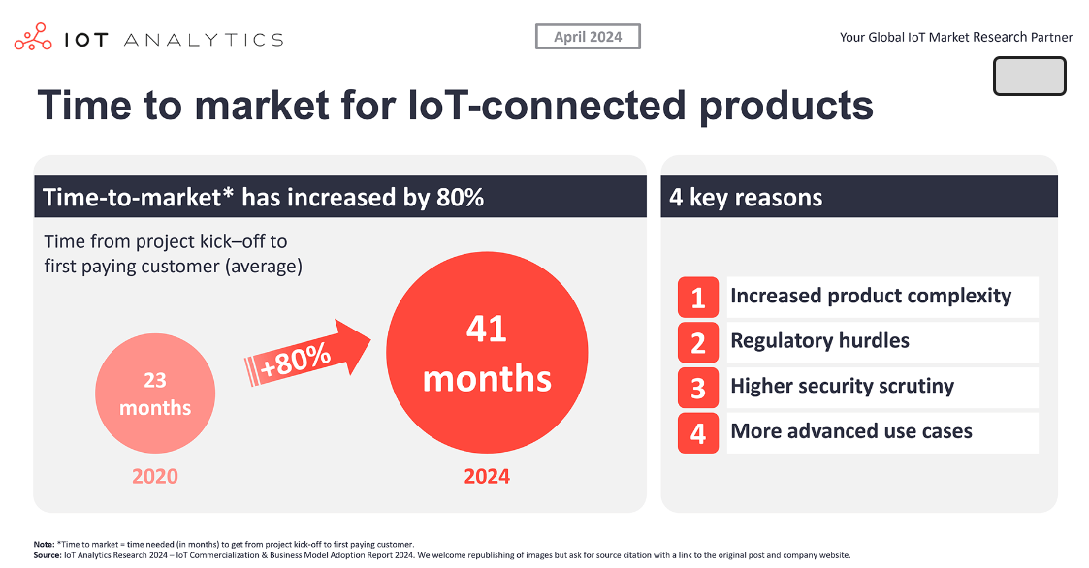
Summary : DSP/ML is complex and it slows time-to-market
Complexity from the “physical domains” and the “software computation domains”
Split the problem in smaller pieces (“computing nodes”)
The Nodes are in Flash, activated by an interpreted scenario of stream processing
A “low-code” scheme is used to add other Nodes

Slide 3
Splitting the problem, looking at the different focus
Silicon vendors
First interest : brute force demonstration of the architecture on micro-kernel
Other interests : the software ecosystem can switch to a new HW architecture
Software developers
First interest : ease of developments with tools, tutorials, compute libraries
Other interests : portability and performance scaling of existing code base
System integrators
First interest : wide catalog of applications, multi-source, decent performance
Other interests : accelerate time to market with good development tools
Many “nodes” pre-installed
in the Flash
Standard interfaces, secured “Stores”
libs : NEON/MVE.. malloc for TCM
Language independent
Graph Interpreter selling message
Graph portability, AI done locally
Low-code, Fast tuning
Avoid failing firmware updates
Self-recovery (drift, warm-boot)

Slide 4

Stream-based processing - different domains of expertise
System and software complexity of a graph of DSP/ML processing is originated from the various domains of expertise
Different data physical domains:
Acoustics
Electrical
Chemical
Mechanical
. . .
Data conditioning
Feature extraction
Classifier
Electronics Signal processing Computer science
Different software engineering domains

Slide 5
Stream-based processing with graph of computing nodes
Data conditioning
Feature extraction
Classifier
Acoustics
Electrical
Chemical
Mechanical
. . .
Multi-domains
Sensor fusion
NPU
Our proposal : stream-processing is implemented with a graph of computing nodes designed independently (from different providers), some nodes can be pre-installed in the Flash of the platform manufacturer
The proof of concept is in production with the graph of EEMBC audiomark using four DSP nodes (beamformer, echo and noise suppressor and a classifier node for Key Word Spotting) running with or without NPU, but with the same node’s interface

Slide 6
Manifests of interfaces for Nodes, Graph-I/O, Processor
Standardized, and formalized interfaces, between nodes, with the scheduler and with the graph interfaces
Stream-processing implemented with a graph of computing nodes
3
1
2
1 Inter-node interface : data format (sampling rate, interleaving, raw format, frame size)
2 Processor interface with nodes : memory allocation and TCM, compute libraries and NPU
3 Graph-I/O interfaces : buffering and polling scheme, mixed-signal configuration of the domains

Slide 7
Graph interpreter and scheduler
The graph intermediate format is a text file, “compiled” to build a scheduling table and a memory mapping
The compiled graph is a linked-list with references to memory buffers and node addresses
Code
Static
FIFO
Scratch
The scheduler checks the FIFO buffers before calling a node instance

Slide 8
Compilation process using “Manifests”
“manifests” of the I/O and nodes are helping the “graph compiler” to build the memory map
and the data flow between Nodes
Graph description
+
Node manifests
Platform manifest
Graph interfaces manifests
List of installed Nodes
List of application callbacks
Compact binary representation of the graph
1. Header.
2. IO-interfaces.
3. Data and stream formats.
4. Scripts of byte codes.
5. Nodes and their parameters
6. Buffer description of arcs.
7. Memory sections.
Graph interpreter (target)
1. Parse the graph I/Os
2. Check the Node’s FIFO
3. Parse the graph of nodes
4. lock the node for execution
5. Update the FIFO R/W
6. Return to application
GRAPH COMPILATION
GRAPH EXECUTION

Slide 9
Graph design

Slide 10
Manifests of Nodes
; --------------------------------------------------------------------------------------
; SOFTWARE COMPONENT MANIFEST - "arm_stream_filter"
; --------------------------------------------------------------------------------------
;
node_developer_name ARM ; developer name
node_name arm_stream_filter ; node name
node_using_arc_format 1 ; to let filter manage q15 and fp32
node_mask_library 64 ; dependency with DSP services
;----------------------------------------------------------------------------------------
; MEMORY ALLOCATIONS
node_mem 0 ; first memory bank (node instance)
node_mem_alloc 76 ; amount of bytes
node_mem 1 ; second memory bank (node fast working area)
node_mem_alloc 52 ;
node_mem_type 1 ; working memory
node_mem_speed 2 ; critical fast
;---------------------------------------------------------------------------------------
; ARCS CONFIGURATION
node_arc 0
node_arc_nb_channels {1 1 2} ; arc intleaved, options for the number of channels
node_arc_raw_format {1 17 27} ; options for the raw format STREAM_S16, STREAM_FP32
node_arc 1
node_arc_nb_channels {1 1 2} ; options for the number of channels
node_arc_raw_format {1 17 27} ; options for the raw format STREAM_S16, STREAM_FP32
end
1 Inter-node interface and interface with the platform :
a text file (readable syntax)
done once at node delivery

Slide 11


Graph (a text file : manual input or generated by a GUI)
Nodes
arm_stream_filter 0
parameters
1 u8; 0
2 u8; 2 0
5 h16; 1231 1D28 1231 63E8 D475
5 h16; 1231 0B34 1231 2470 9821
_end_
Node name instance index Boot preset,
Options : Memory allocation, pre/post processing script,
Dedicated architecture, processor (or any), priority, trace verbose level
Memory mapping of each segment
Arcs
Node name instance index arc output index
Node name instance index arc input index
arm_stream_filter 0 1
arm_stream_detector 0 0
BOUNDARY ARCS
Index of the IO
_graph_interface 4 1
arm_stream_filter 0 0

Slide 12
“Compiled” Graph (used by the scheduler)
00000000
00009123
00000010
00000006
00000001
000000FF
00000000
FFFFFFFF
FFFFFFFF
FFFF3000
00000000
FFFF3802
00000000
22000008
467A0000
00000003
2200000C
467A0000
00000004
22000008
0000001F
00000000
00000003
00030000
05900004
AD020200
90B19261
02020005
000261AD
01020102
90B17100
00029801
48010000
1000006F
00000090
00300007
12310002
12311D28
D47563E8
0B341231
24701231
00009821
00049802
48020001
08000082
00420001
000003FF
00000053
00000008
00000000
00000000
00000055
00000008
00000000
00000000
00000057
08000010
00000000
00000000
0000005B
08000010
00000000
00000000
0000005F
00000024
00000000
00000000
00000068
0000001C
00000000
00000000
Header
IO interfaces
Data formats
Scripts
Nodes
Arcs
Memory and address destination of the graph in the device,
Indexes to the sub-sections below, amount of memory released from maximum allowed
Index to table of IO functions
(io_function_ctrl) (command, uint8_t *data, uint32_t length);
“Reset”, “Set Parameter”, “Move data”, “Stop”
Arc ID interacting with this IO, Data format, Settings at reset
Frame size, interleaving and time-stamp scheme,
raw data type, Nb of channels, Sampling rate,
Domain-dependent settings
Byte codes : arithmetics, access to FIFO,
update the nodes parameters,
software timers and basic state-machines
5 words per nodes + parameters : processor and arch selection, number of arcs, scripts to call before and after, index of the node
List of arcs IDs, their block of memory assigned for debug/trace.
List of memory blocks (address, size, address of swap/copy to slower memory) asked in the node manifest
Parameters : preset (among 16), selection of a specific parameter subset to update after preset, Byte-stream of parameters
ARC descriptors :
Producer and consumer Data format
Base address of the buffer using a base offset ID and a signed byte index. Buffer size, Read and Write index.
Debug command and result register index.
Collision of node access protocol (Dekker’s algorithm), flag for the need of buffer data realignment.

Slide 13
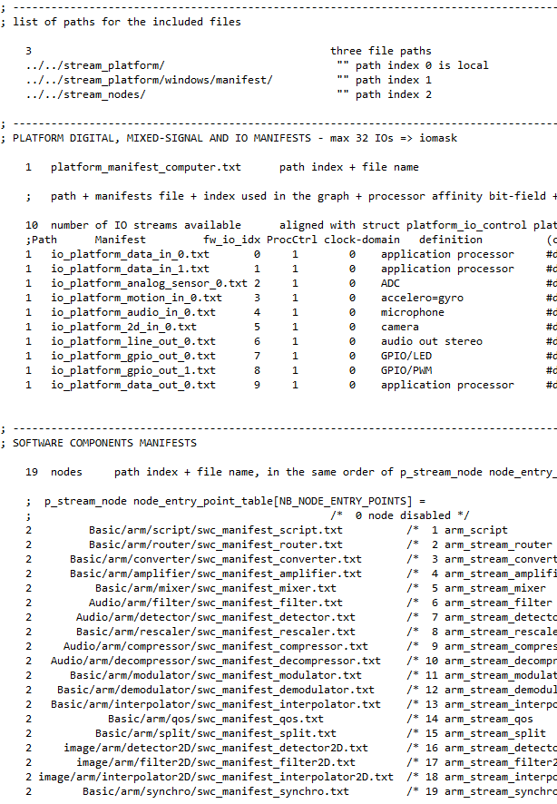
Root file of the platform details (all the manifests used by the translation tool)
Processor manifest
List of available IO for stream processing
Abstraction layer = data move, set buffer, set parameter, stop
Stream physical domains: generic data_stream, audio, gpio, motion, 2D,
analog_sensor, analog_transducer, rtc
List of available Nodes

Slide 14
Processor manifest : memory mapping
1 1
1 1 4 1 9 15
0 h20000000
1 h28000000
2 h2C000000
3 h08000000
; ID VID S W P H D Size offset
0 0 1 0 0 0 0 95526 10
0 1 0 0 0 0 0 65526 10
0 2 0 0 0 0 0 30000 65536
0 3 0 1 0 0 0 15000 95536
0 4 0 1 0 0 0 256000 262144
2 1 3 1 1 0 0 1024 262144
1 10 0 2 0 0 0 1024 524288
3 20 0 0 0 0 0 200000 10
2 8 3 1 1 0 1 16384 0
Number of architectures, number of processors
Processor ID, Main processor identification, FPU characteristics
Number of memory banks below, bit-field of installed compute libraries
Indexes used in the FIFO descriptors to address the data
Physical memory banks:
- base offset ID reference above
- virtual ID used in the graph for manual mapping
- Speed normal/fast/critical-Fast, static0/working1/retention2, shared0/private1, for DMA, Data0/Prog1
- minimum size guaranteed
- minimum offset from the base offset ID

Slide 15
Manifests of interfaces for Graph-I/Os
3
3 Graph-I/O interfaces :
a text file (readable syntax)
done once at platform manufacturing
io_platform_sensor_in_0 ; name for the tools
analog_in ; domain name, unit: dB, Vrms, mV/Gauss, dps, kWh, ...
io_commander0_servant1 1 ; commander=0 servant=1 (default is servant)
io_buffer_allocation 2.0 1 ; default is 0, which means the buffer is declared outside of the graph, VID 1
io_direction_rx0tx1 1 ; direction of the stream 0:input 1:output from graph point of view
io_raw_format {1 17} ; options for the raw arithmetics computation format here STREAM_S16
io_nb_channels {1 1 2} ; multichannel intleaved (0), deinterleaved by frame-size (1) + options for the number of channels
io_frame_length {1 2 16} ; [ms]0/[samp]1 + options of possible frame_size
io_subtype_units 104 ; depending on the domain. Here Units_Vrms of the "general" domain (0 = any or underfined)
io_analogscale 0.55 ; 0.55V is corresponding to full-scale (0x7FFF or 1.0f) with the default setting
io_sampling_rate {1 16000 44100 48000} ; sampling rate options (enumeration in Hz)
io_rescale_factor 12.24 -44.3 ; [1/a off] analog_input = invinterpa x ((samples/Full_Scale_Digital) - interpoff)
end

Slide 16
Graph API (one entry-point to the scheduler)
1) Graph interpreter interface for the application :
void arm_graph_interpreter (uint32_t command, arm_stream_instance_t *S, uint8_t *data, uint32_t size)
Commands : reset the graph, execute, check boundary FIFO filling state and move data in/out, update the use-case
Instance : structure of pointers to the graph, to the installed nodes and application callbacks, to the data stream interfaces functions (below),
control fields and static memory of the scheduler instance.
2) Stream interfaces used by the scheduler to initiate data moves (abstraction layer of the BSP):
void (io_function_ctrl) (uint32_t command, uint8_t *data, uint32_t length);
Commands : set buffer, set parameters, data move, stop
3) One callback, after data moves (to update the FIFO descriptors) :
void arm_graph_interpreter_io_ack (uint8_t fw_io_idx, uint8_t *data, uint32_t data_size)
4) One prototype for all nodes :
void node_XXXX (uint32_t command, void *instance, void *data, uint32_t *status)
“manual” flow control from the application or
let the scheduler call the BSP
Abstraction layer of IOs : data-move and settings + callback to set the FIFO
or
Data move from the application with same functions for FIFO setting
FIFO 1
FIFO2
FIFO 2
FIFO 3
SWC1
SWC2

Slide 17
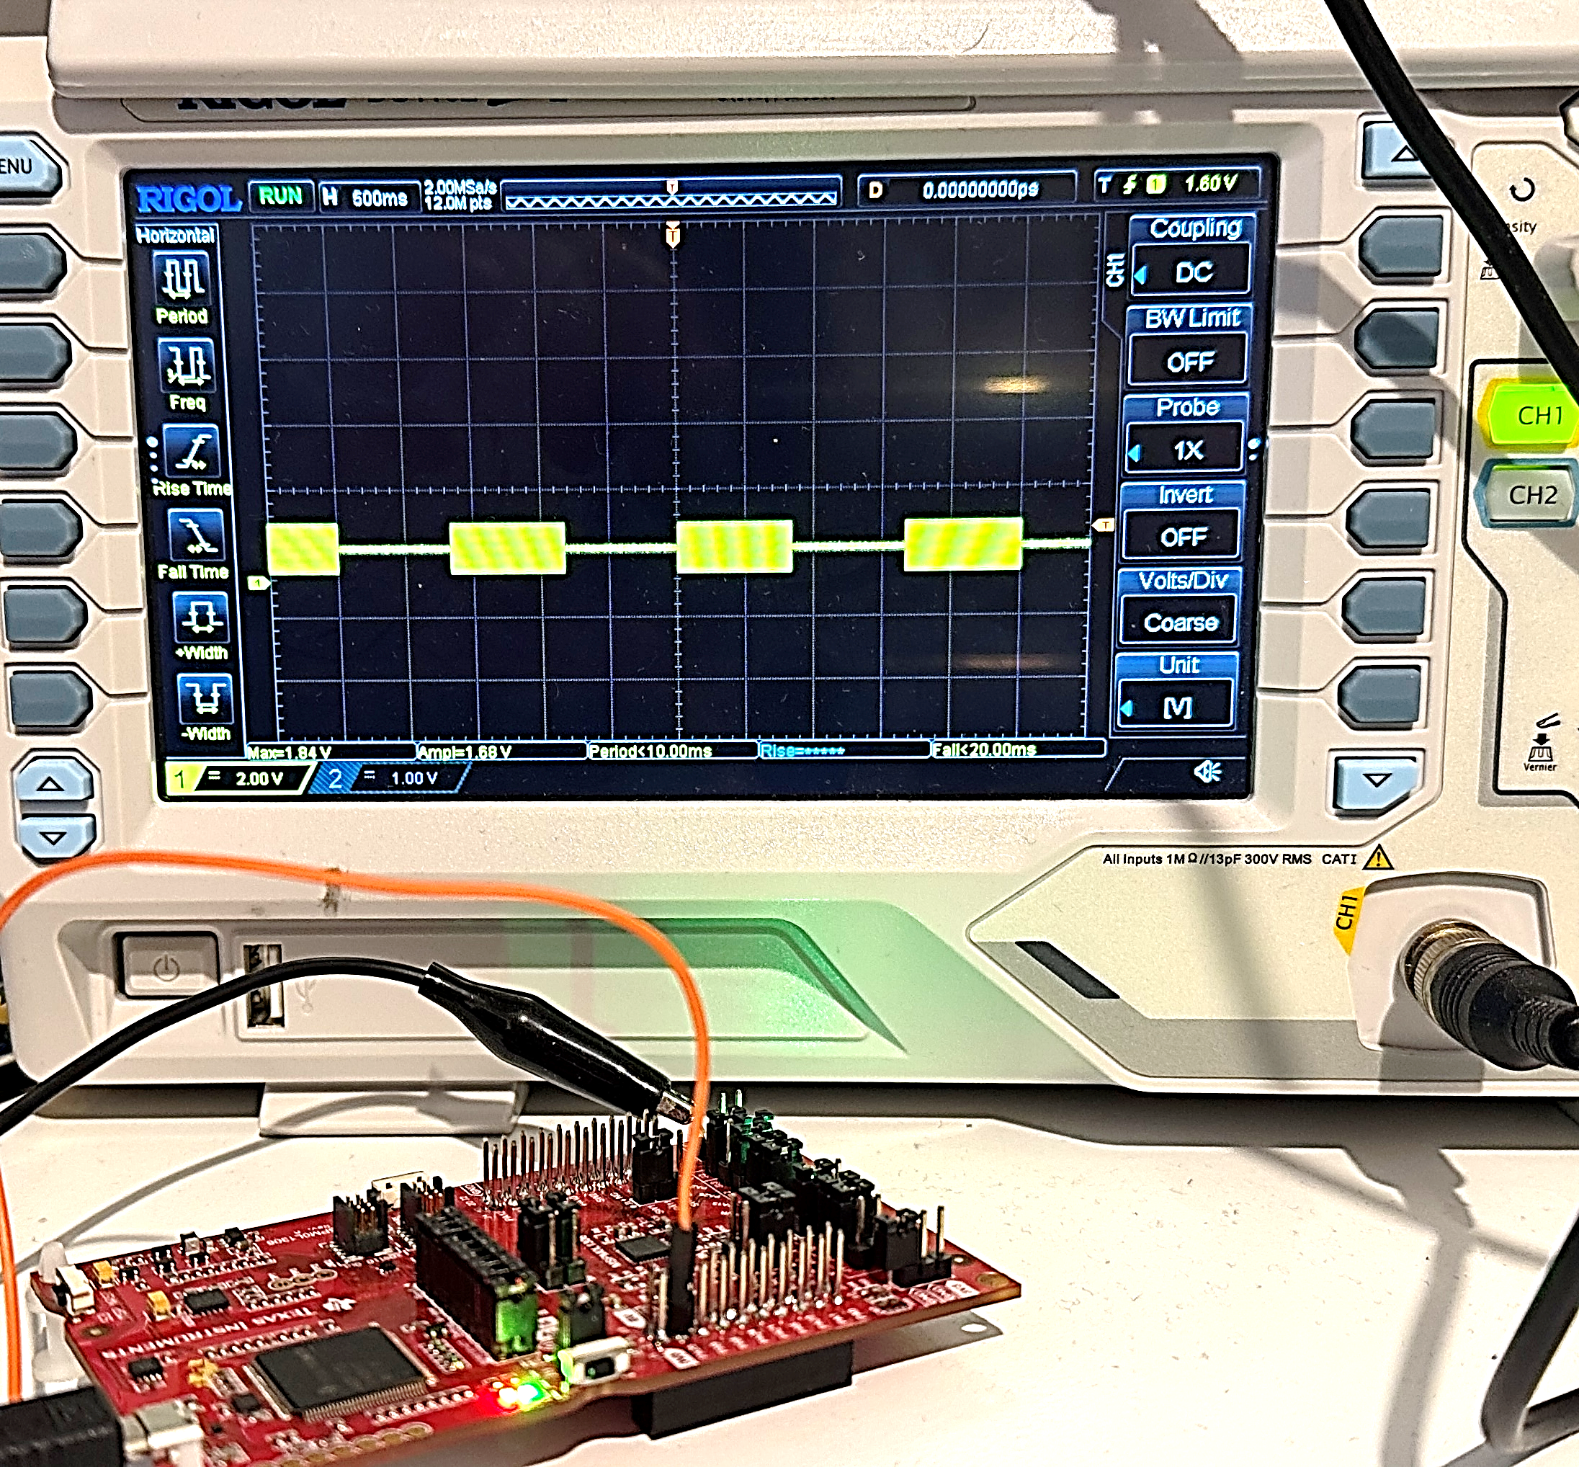
Small memory footprint for LoRA
Remote sensors connected through LoRA have a data rate as low as 50Bytes/s
A graph size of two nodes (+ their respective parameters and a script) is in the 500Bytes range
An interpreter eliminates the risk of malware injection during firmware updates
A memory map of the LoRA device :
RAM (graph and application)
Flash (graph, Nodes, application)
Filter and detector nodes with 1kB-RAM

Slide 18
Graph with embedded scripts
A graph can incorporate nodes with interpreted code using basic integer/float arithmetics.
The instruction “CALLSYS” gives access to nodes (set/read parameters), arcs (read/write, check access time-stamps), application callbacks, etc..
The script interpreter is consuming less than 100 Bytes of stack memory.
Why would you need Python for very simple operations ?
Examples of instructions
r6 = add r5 3 r6 = ( r5 + 3 )
sp1 = r6 push the result on stack
test_eq r6 sub r5 r4 test if r6 == ( r5 - r4 )
if_yes call label_xyz conditional call
r0 = mul r6 #float 3.14 r0 loaded with r6 multiplied by 3.14
r3 | 8 15 | = r2 bit-field load of r2 to the 2nd byte of r3
r3 = [ r4 ] r0 gather load
banz L1 r2 decrement r2 and branch if not zero
call L1 r2 r3 call a subroutine and push 2 registers
Other operations: div,or,nor,and,xor,shr,shl,set,clr,max,min,amax,amin,norm,addmodulo
callsys 4 r1 r5 r10 system call #4 with three parameters

Slide 19
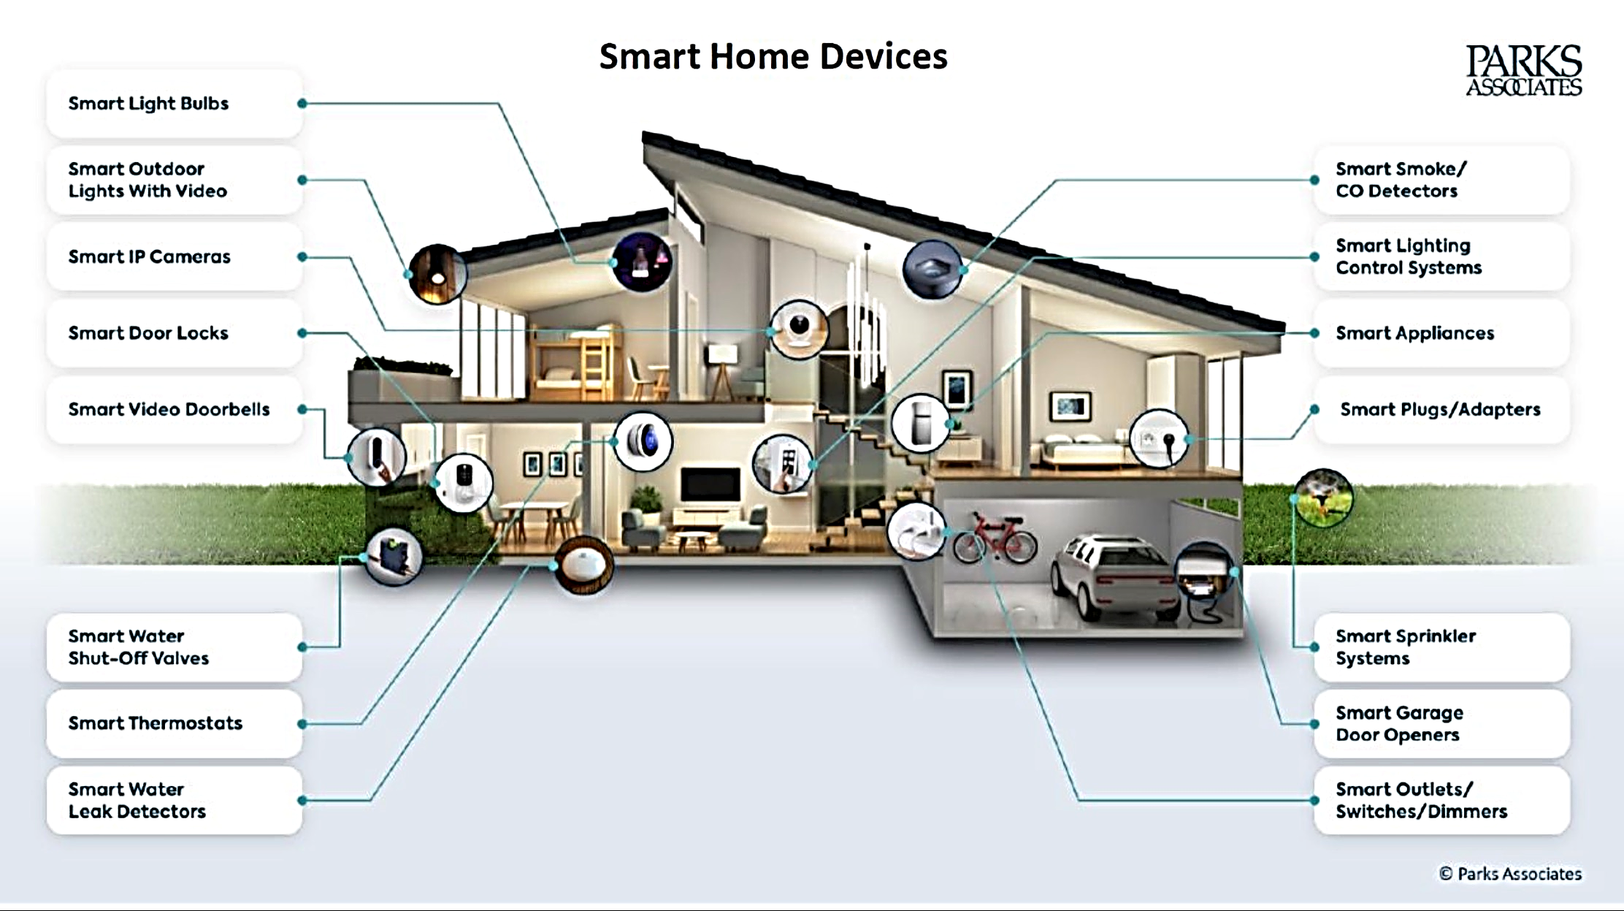
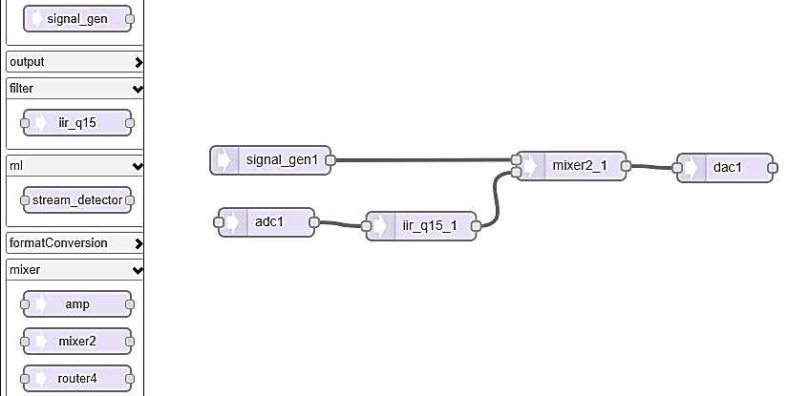
Next steps : low-code for smart-home sensors
Do we need a complex programming environment to drag and drop software components from a Store ?

